Slide 1
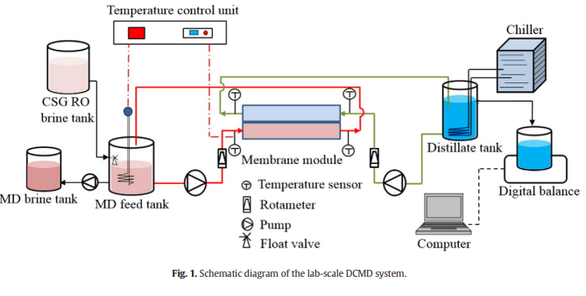
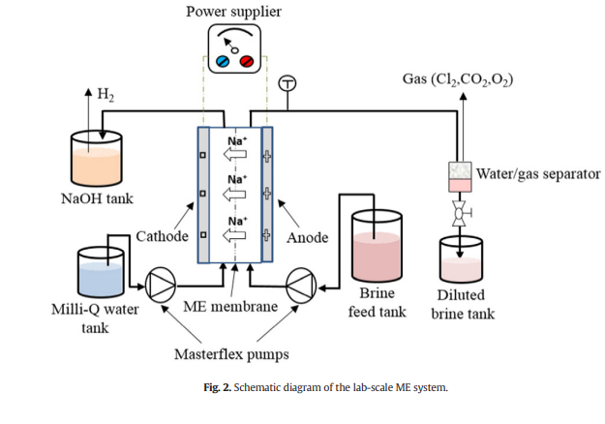
Integrated Membrane Processes for Water Extraction and NaOH Production from Coal Seam Gas Reverse Osmosis Brine
DESGIN CREDIT UNDER VIKKY ANAND.

Slide 2
ABOUT THE TOPIC
Membrane distillation (MD) and membrane electrolysis (ME) were evaluated for simultaneous fresh water extraction and NaOH production from a mixture of NaCl and NaHCO3 to simulate the composition of coal seam gas (CSG) reverse osmosis (RO) brine.
The ionic composition of CSG produced water is mostly Na,Cl-,NaHCo3-.
RO process is used for CSG waste water treatment.
CSG RO brine is stored in evaporation ponds, But this a costly method.
NaOH is produced from CSG RO brine by the ME(membrane electrolysis).
Feed stock for NaOH production has been sourced mostly from rock salt, conc. Salt lake brine, conc. Sea water.

Slide 3
EXPERIMENTAL SETUP & PROTOCOL
MATERIALS
Lab-Scale MD Test System:
Direct Contact Membrane Distillation (DCMD) system used.
Plate-and-frame membrane module with two flow channels.
Flat-sheet membrane made of low-density polyethylene (LDPE).
Synthetic CSG RO brine heated and circulated in the feed channel.
Distillate circulated through distillate channel with temperature control.
Digital balance is measured through computer programming.
Lab-Scale ME Test System:
Membrane Electrolysis (ME) system included a membrane module and power supplier.
Cation exchange membrane with programmable power supply (up to 18 A).
Peristaltic pumps circulated brine and Milli-Q water through anode and cathode cells.
Synthetic CSG RO Brine:
Synthetic solution simulating CSG RO brine with NaCl and NaHCO3.
Similar parameters to CSG RO brine from a pilot study (TDS, conductivity, pH).
Synthetic brine used to maintain applicability of the study.

Slide 4
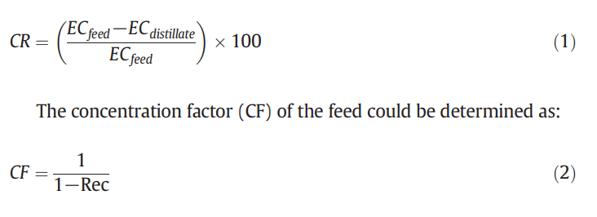
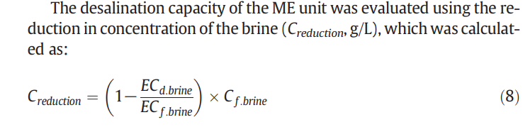


EXPERIMENTAL PROTOCOL
DCMD Operation of CSG RO Brine:
DCMD concentration conducted to determine maximum achievable concentration factor.
FEED temperature=45 degree celcuis and distillate temperature=25 degree celcuis and circulation rate of 1L/min.
CR= CONDUCTIVITY REJECTION EC= ELECTRICAL CONDUCTIVITY
Where Rec is the system water recovery ratio between accumulated distillate volume and initial feed volume.
New membrane is used in each DCMD experiment at the completion of each experiment the used membrane was air dried and stored in a desiccator for subsequent surface analysis.
ME OPERATION OF MD BRINE:
ME exp with MD brine showed that influence of operating condition on the NaOH production, desalination efficiency, thermal energy requirement.

Slide 5
Analytical Methods:
Electrical conductivities measured using Orion 4-Star Plus pH/conductivity meters.
MD membrane surface morphology analyzed using SEM with gold coating.
X-ray diffraction (XRD) used to identify crystals on membrane after DCMD.
Strength of produced NaOH in ME experiments determined gravimetrically.

Slide 6
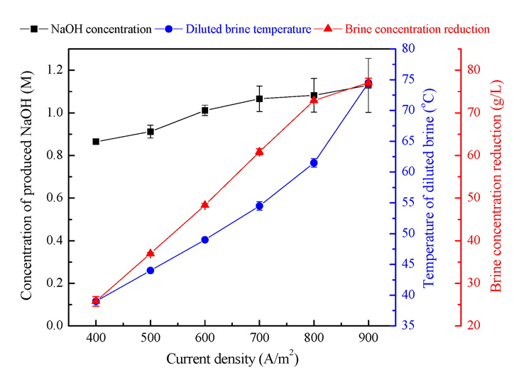
RESULT AND CONCLUSION
DCMD TREATMENT OF CSG RO BRINE
Feed salinity increase resulted in a decrease in water activity. As a result, it led to a decrease in the DCMD water flux as the concentration factor increased from 1 to 11 (i.e. corresponding to increased salinity from 17.1 to 188.1 g/L)
Increasing feed salanity awakens the concentration polarization effect in DCMD, measured water flux diverged more hence feed viscocity increases.
The model and calculations provided insights into the impact of feed salinity on water flux.
Membrane reuse demonstrated the process's sustainability and adaptability.
Results reported in Fig demonstrate the feasibility of MD for producing fresh water and simultaneously concentrating CSG RO brine prior to the ME process for NaOH production.
MD process, which is only 2.5% of the initial volume of CSG produced water, can be fed to ME for the production of NaOH.

Slide 7
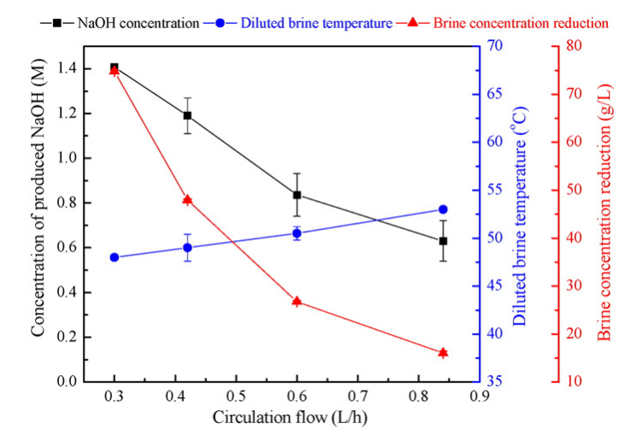
ME Treatment of MD Brine for NaOH Production:
Current density exerted a strong effect on the ME process. Elevating the current density increases the movement of ions.
Elevating current density also increases the temperature of the diluted brine.
Circulation flow chart
Specific auxiliary thermal energy requirement (α) calculated per unit mass of NaOH.
Specific thermal energy co-generation (β) assessed based on temperature difference.
Significance: Quantifies energy efficiency and process cost in NaOH production.
The findings demonstrate that optimizing the process of combining MD and ME for NaOH production from CSG RO brine relies on current density and circulation flow rates. By coordinating MD and ME conditions effectively, we can prevent unnecessary heating of the feed and excessive heat production from ME.

Slide 8
CONCLUSIONS
Synergistic MD and ME Treatment
Simultaneous Clean Water Extraction and NaOH Production
Tolerating Increased Feed Salinity
Extended MD Operation at Higher Concentration
ME Process Efficiency Influenced by Operating Parameters
Energy Savings through MD-ME Integration:
MD-ME combination enabled thermal energy savings for both processes.
Energy savings: 3 MJ per 1 kg of NaOH produced by ME, and 22 MJ per 1 m3 of fresh water extracted by MD

Slide 9
THANKS

